Slide 1

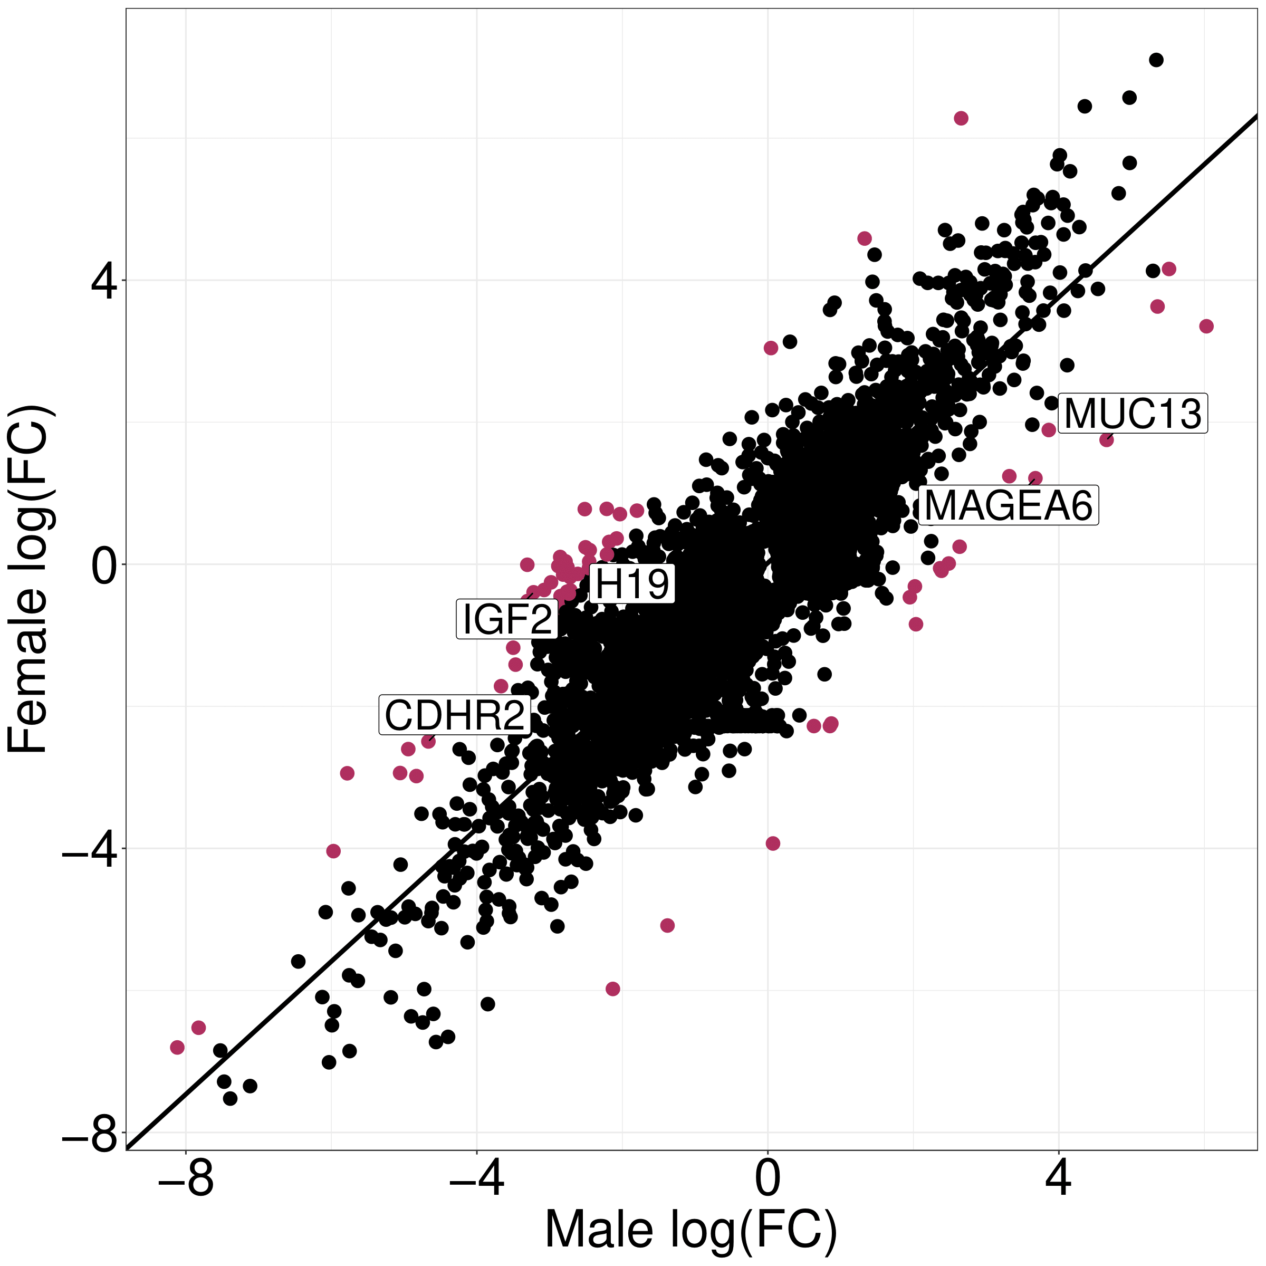
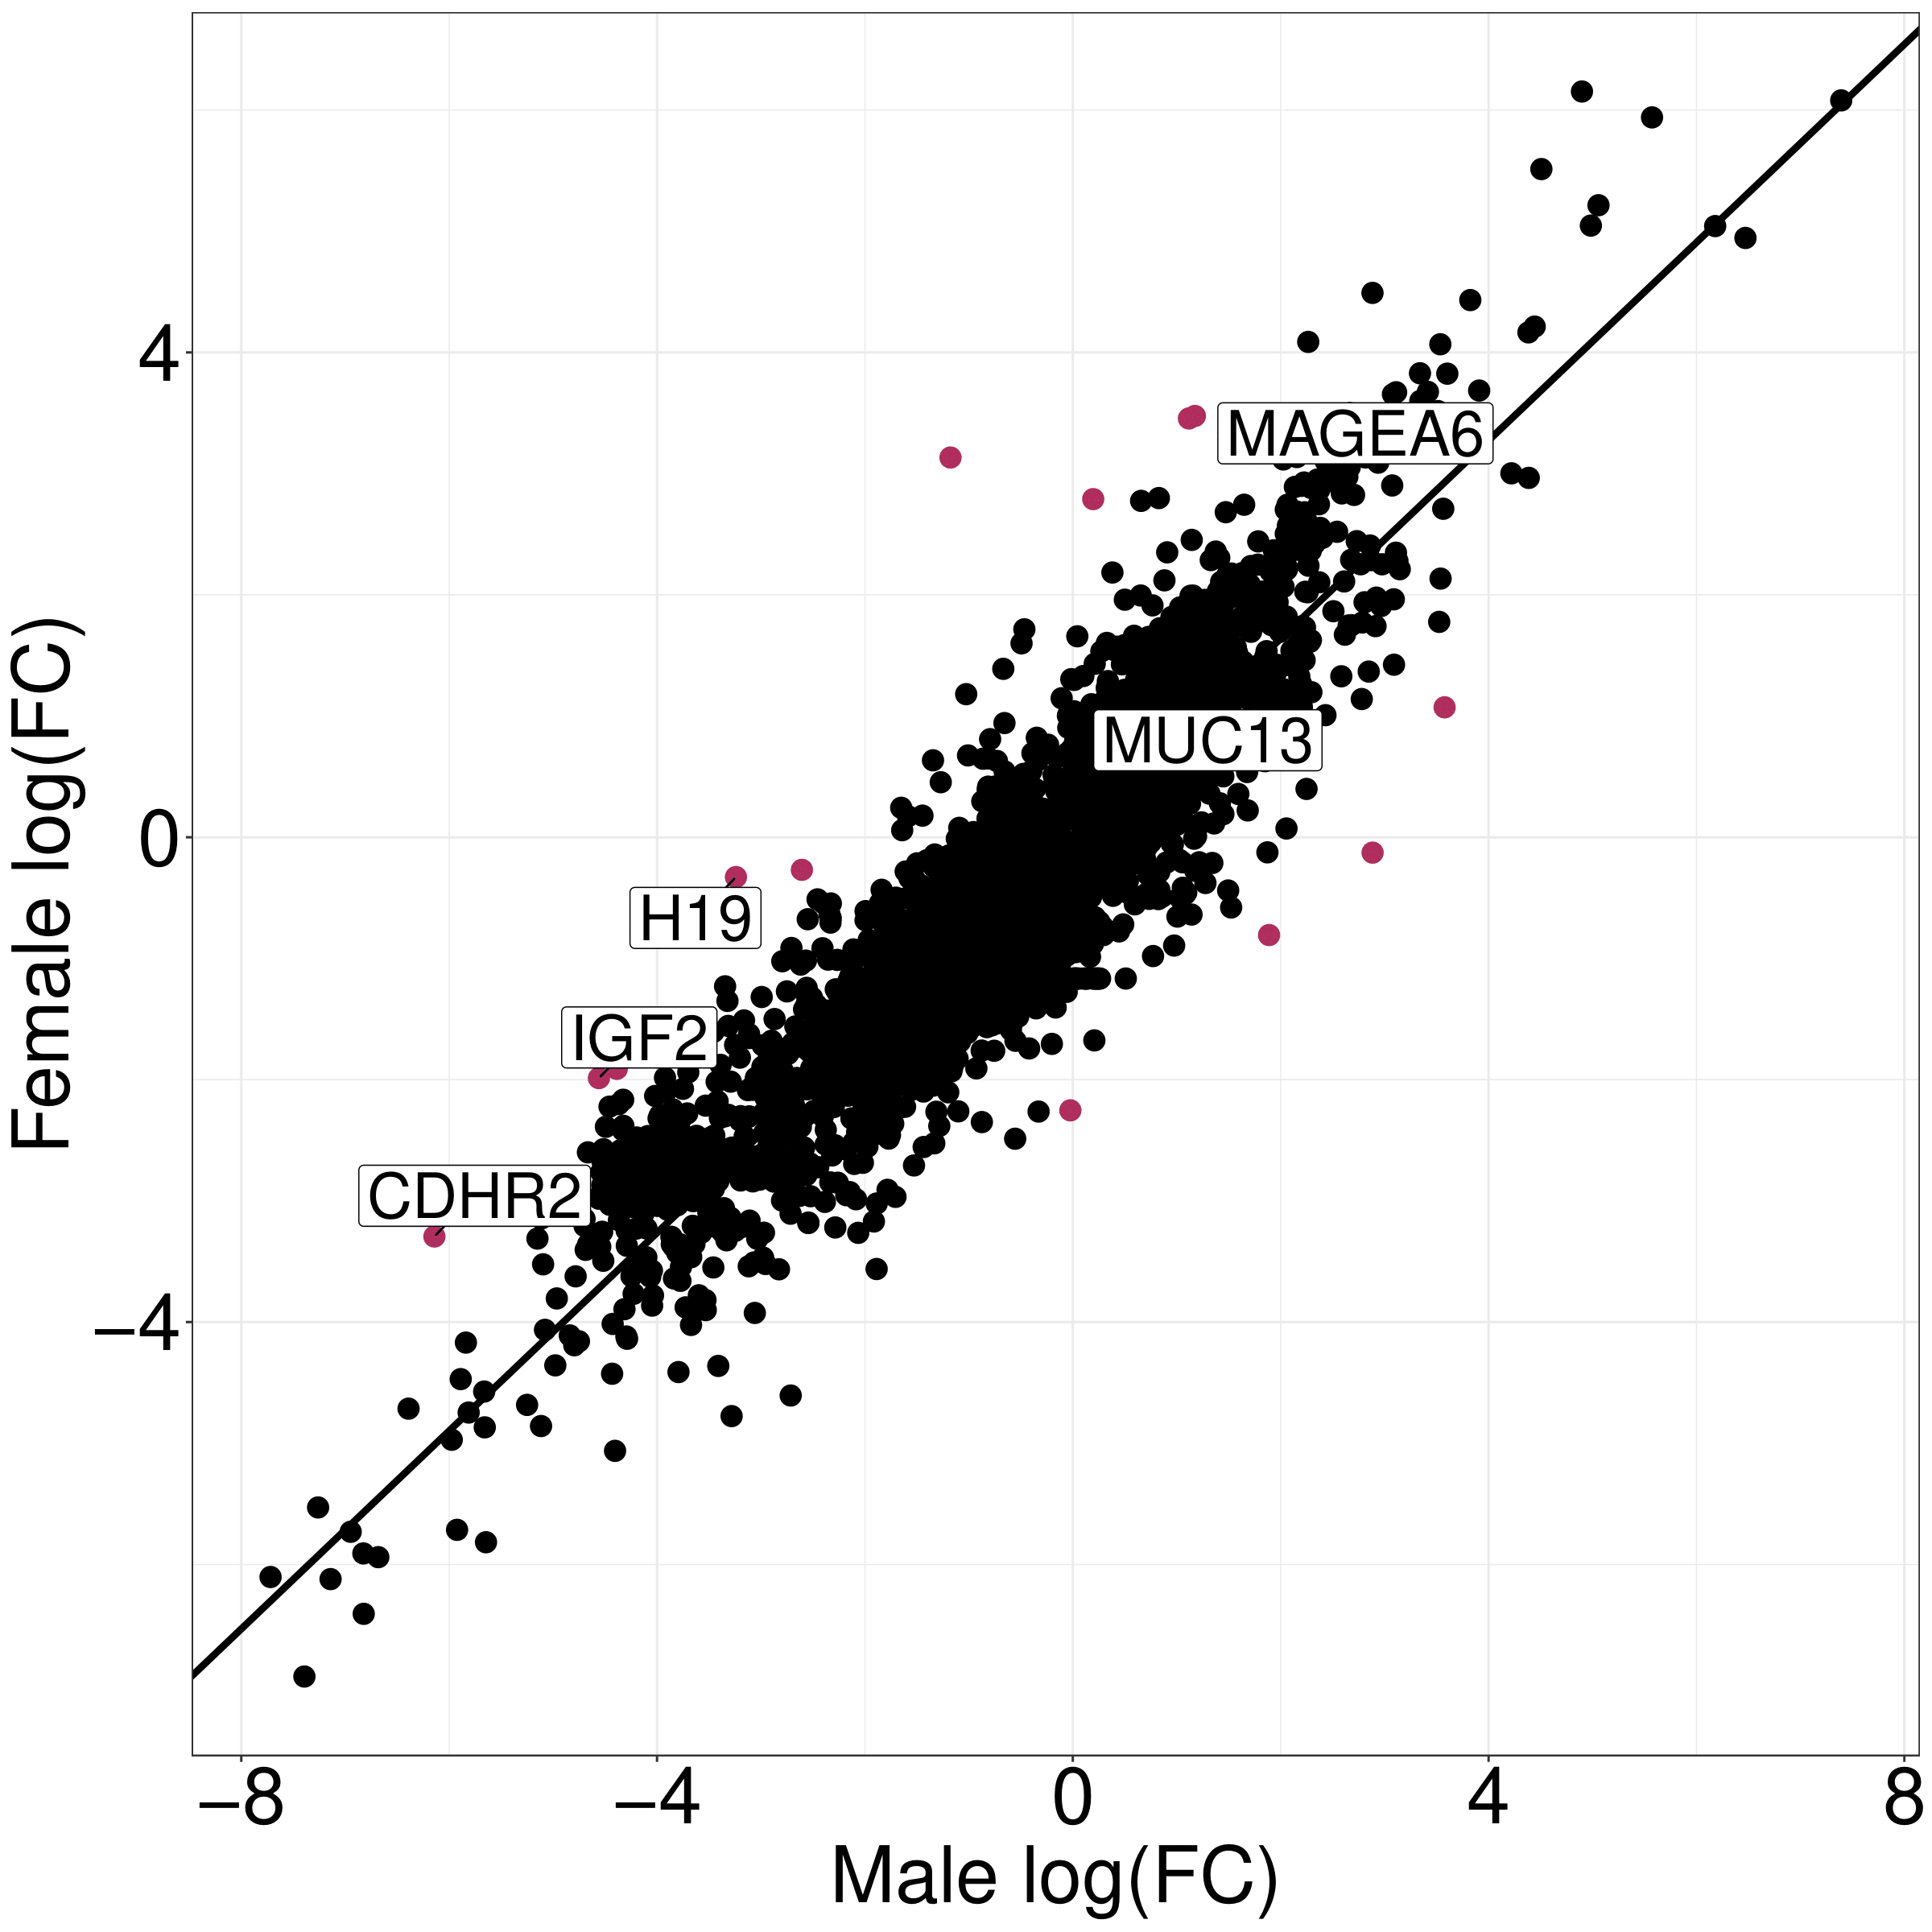
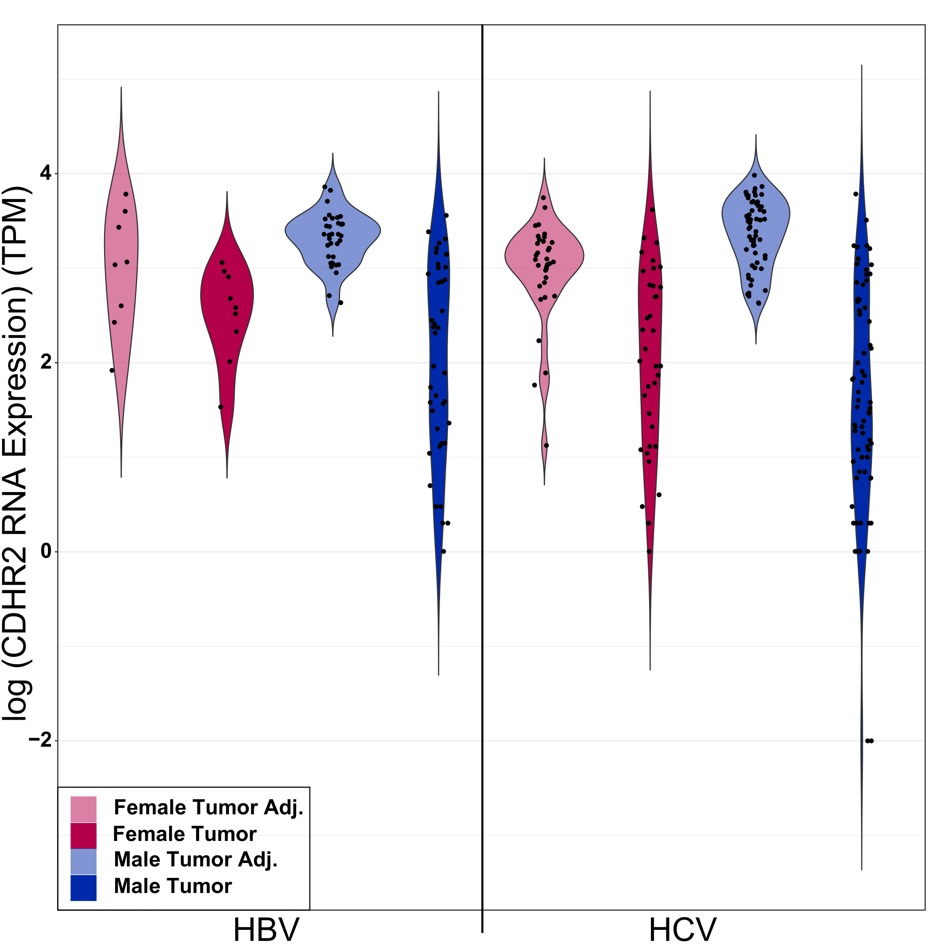
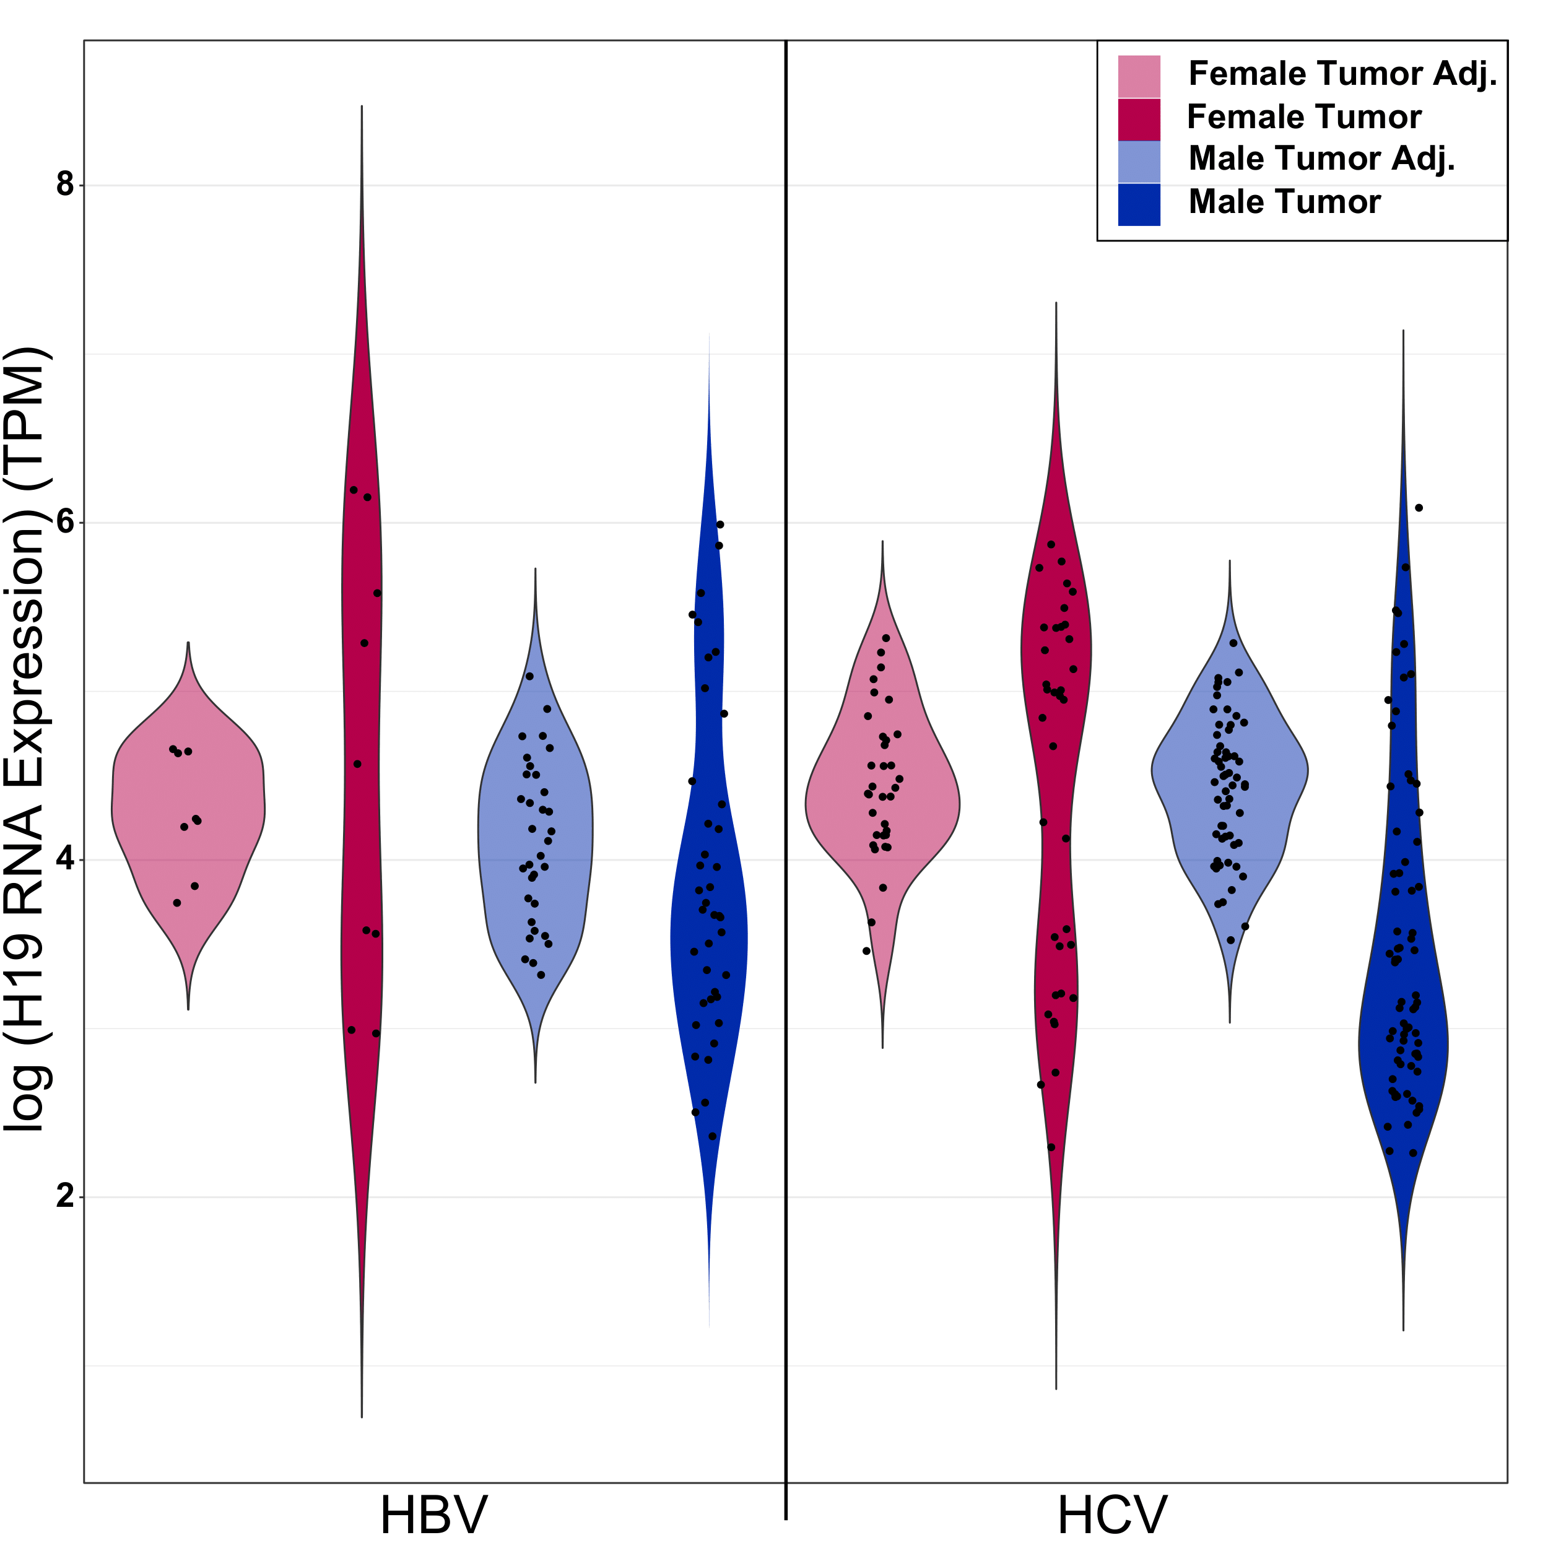
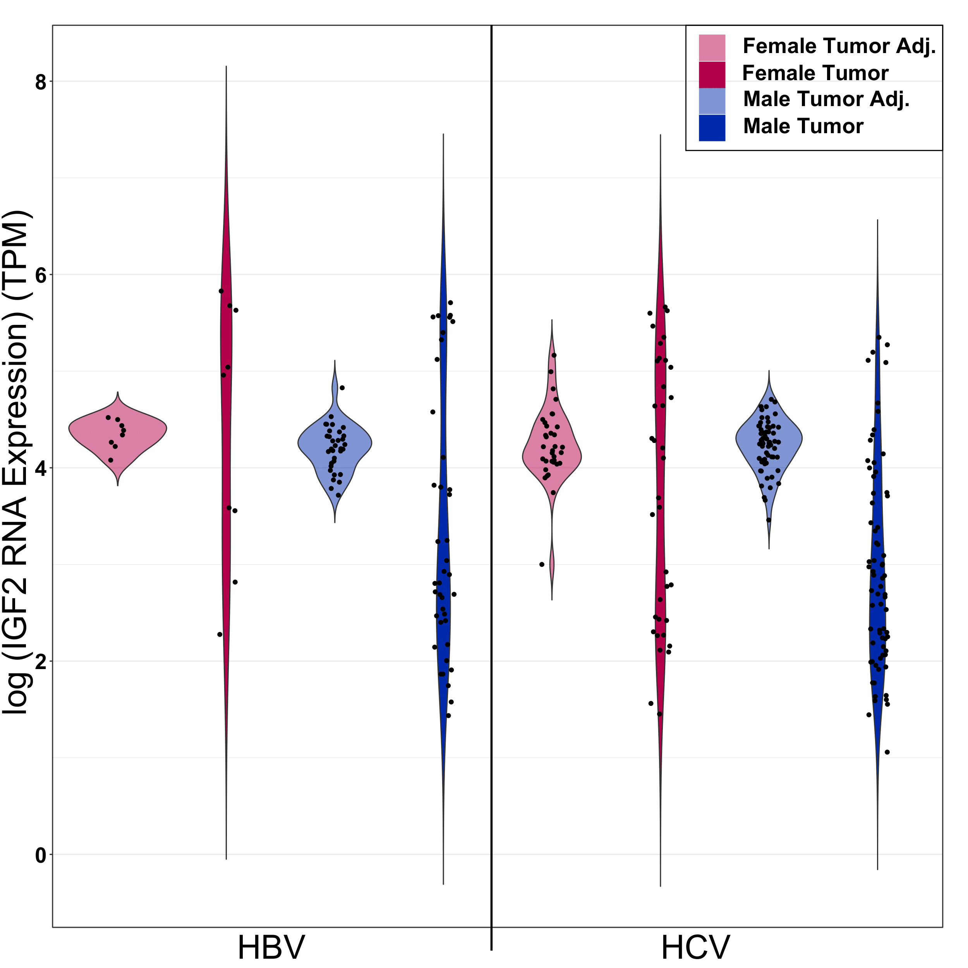
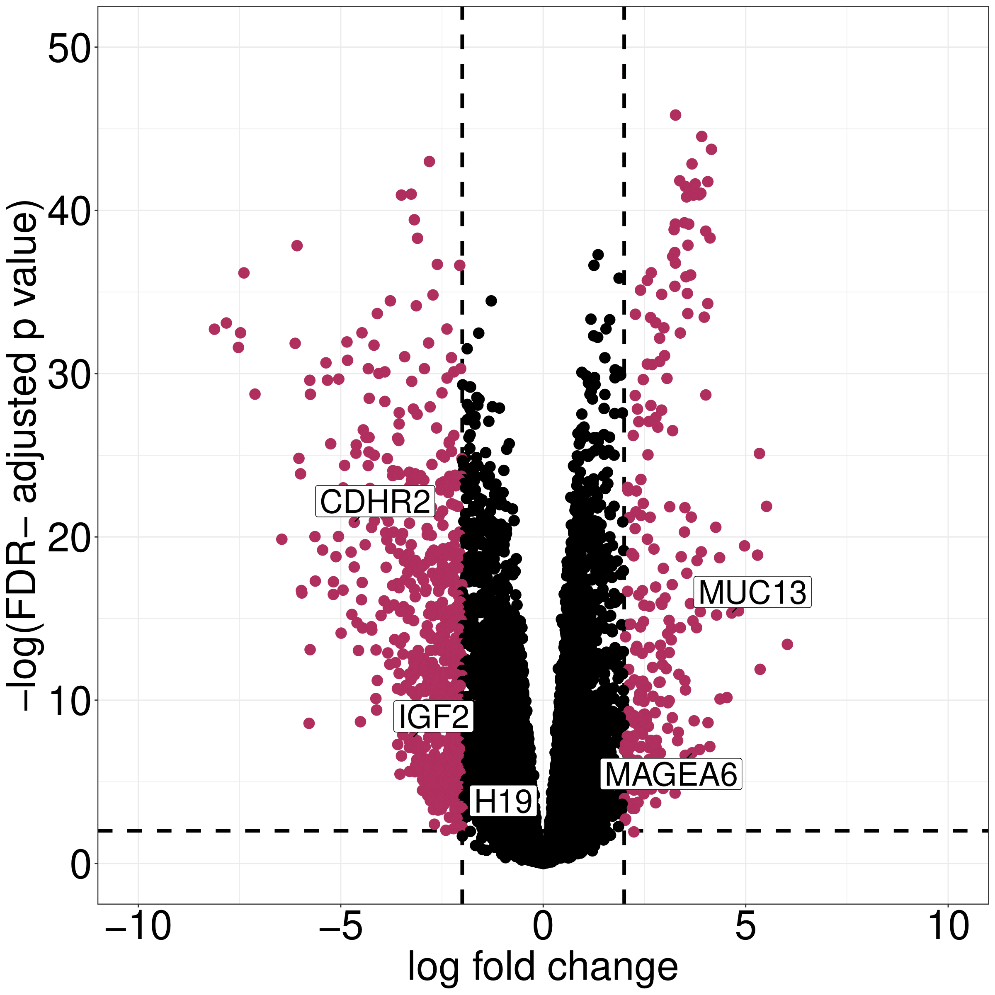
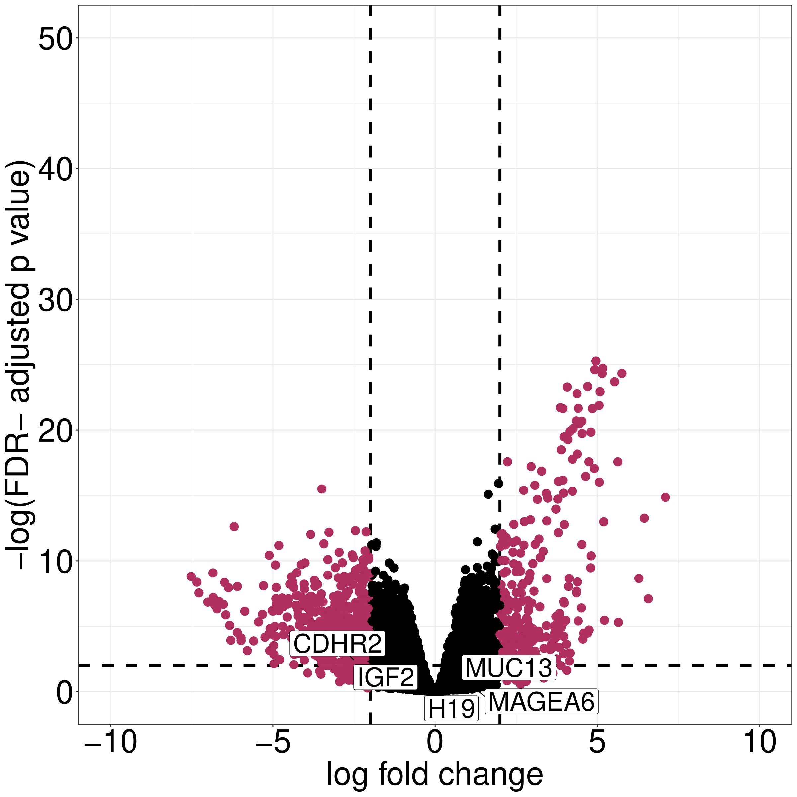
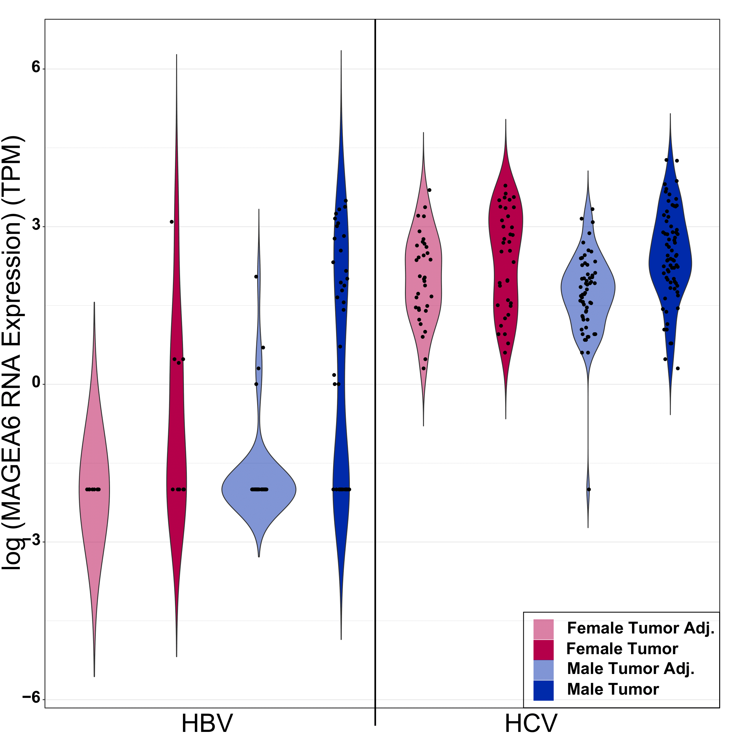
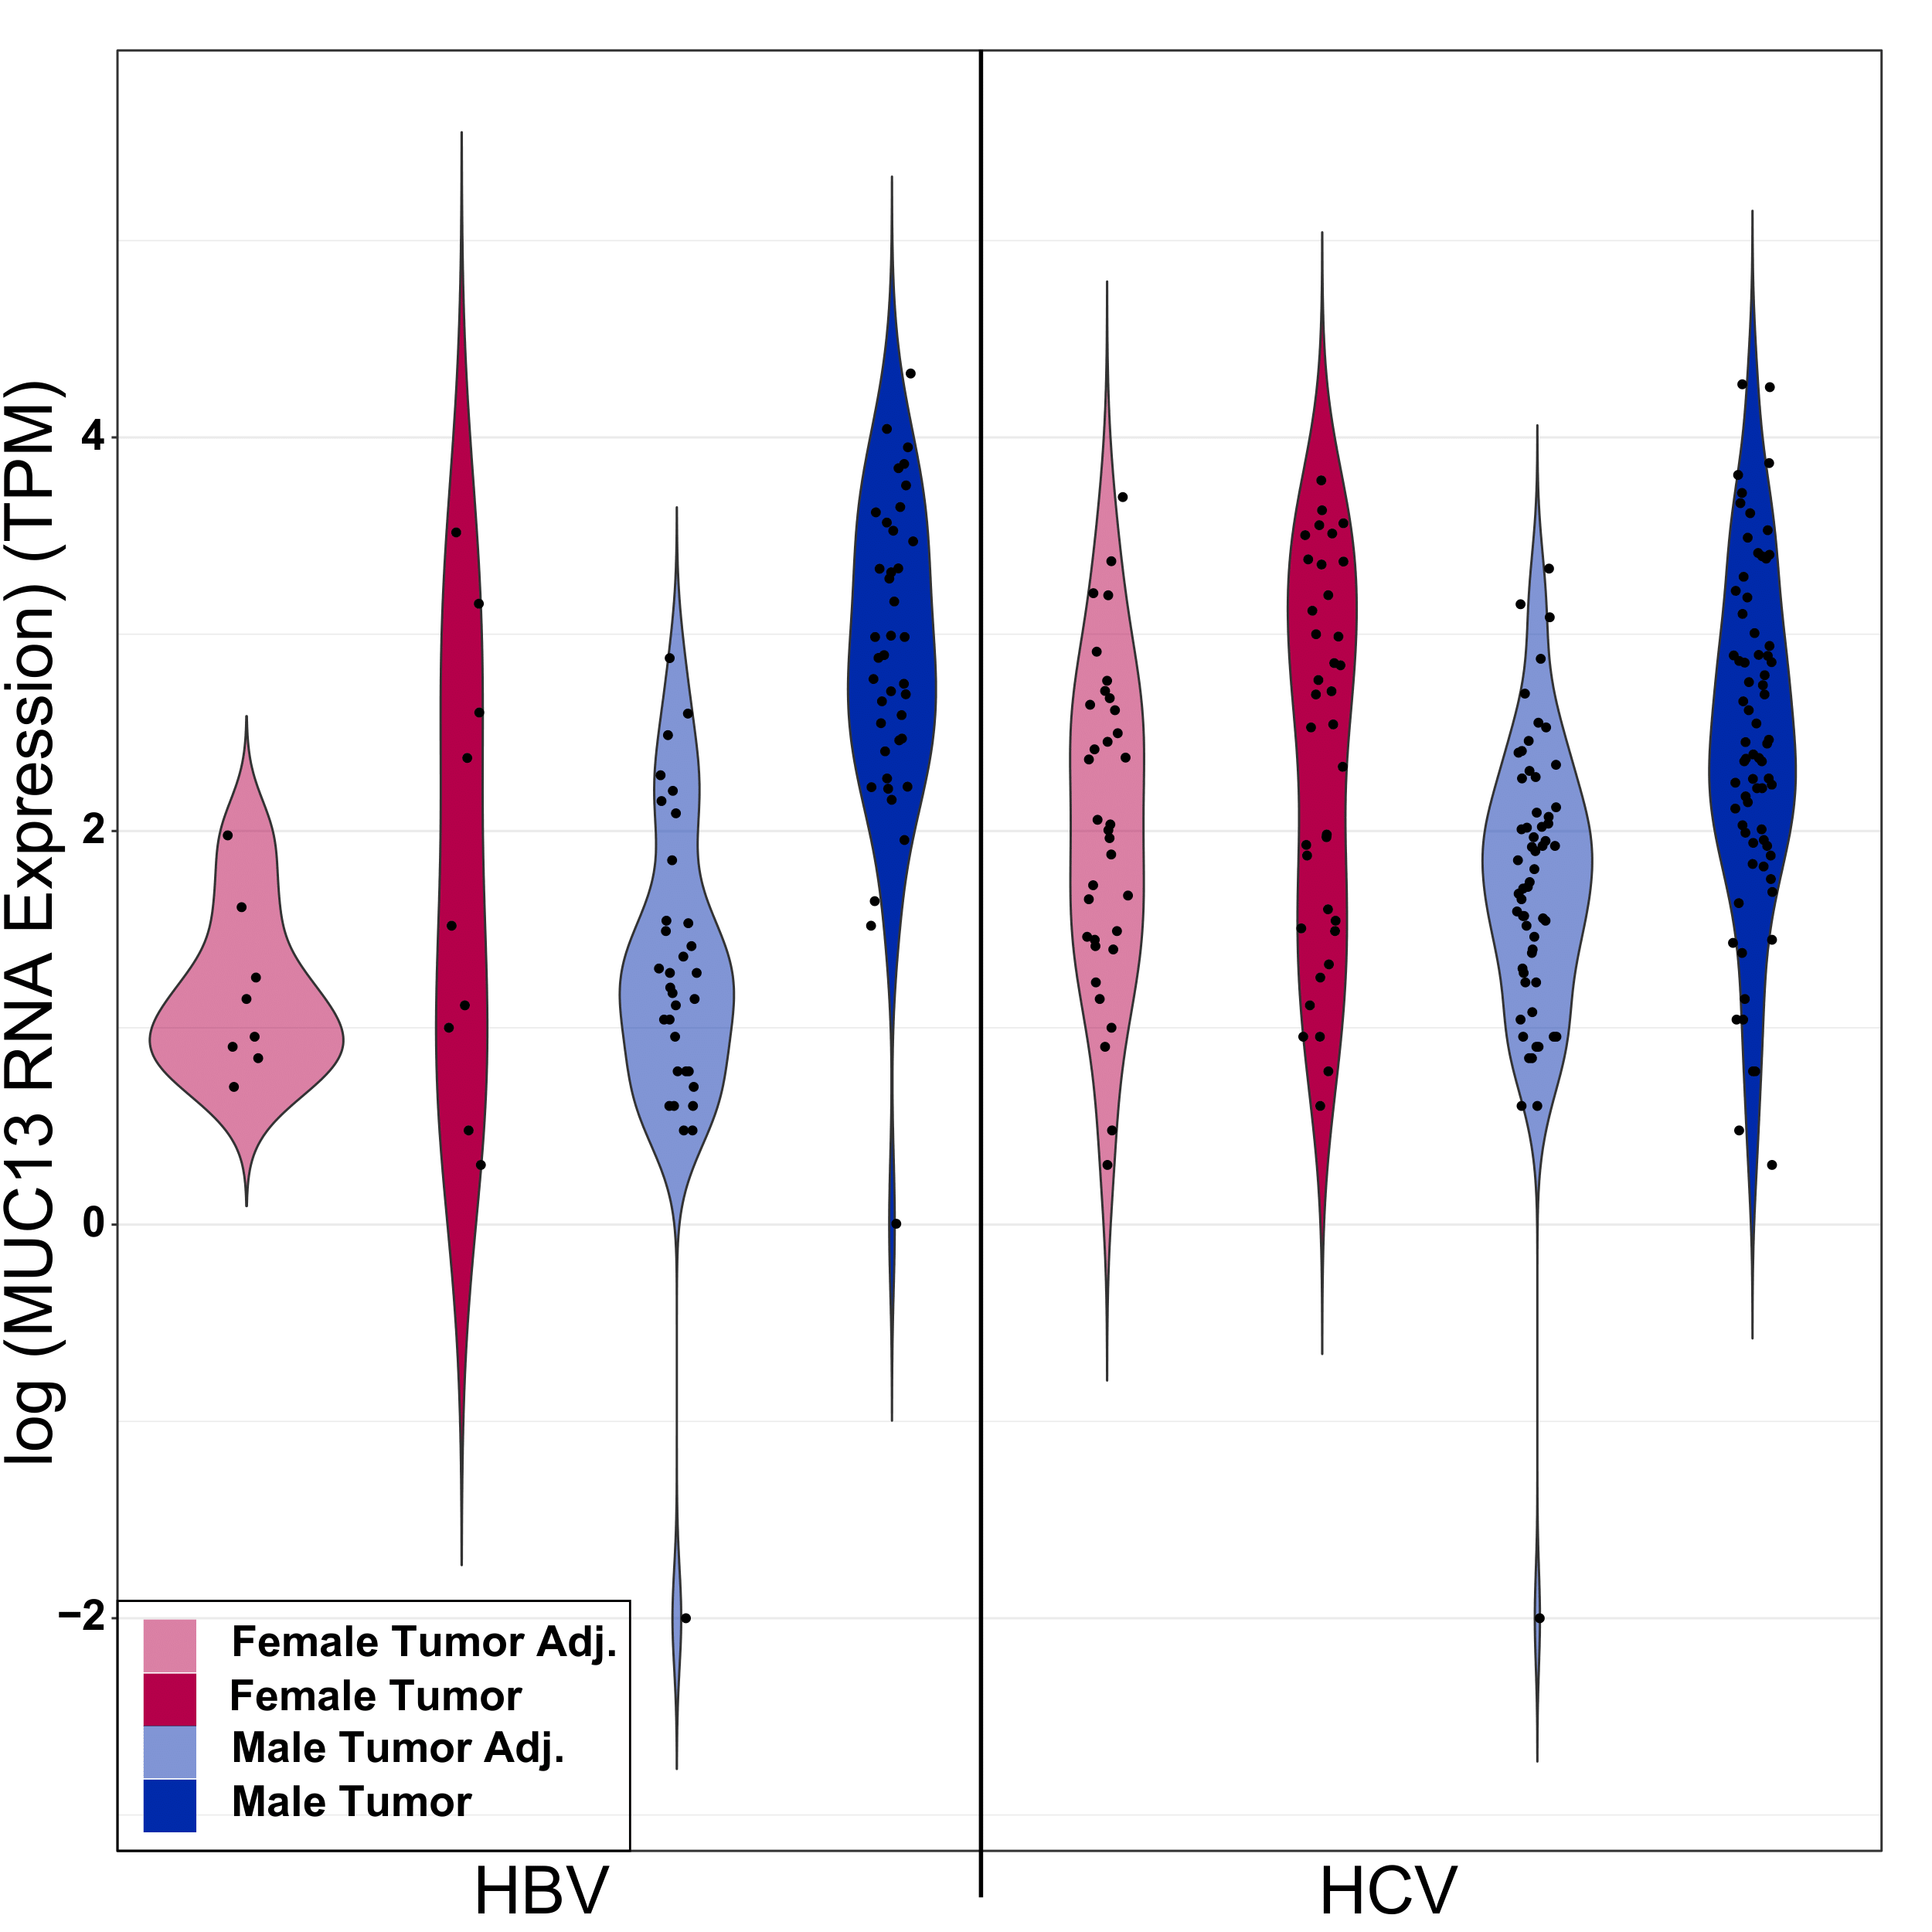
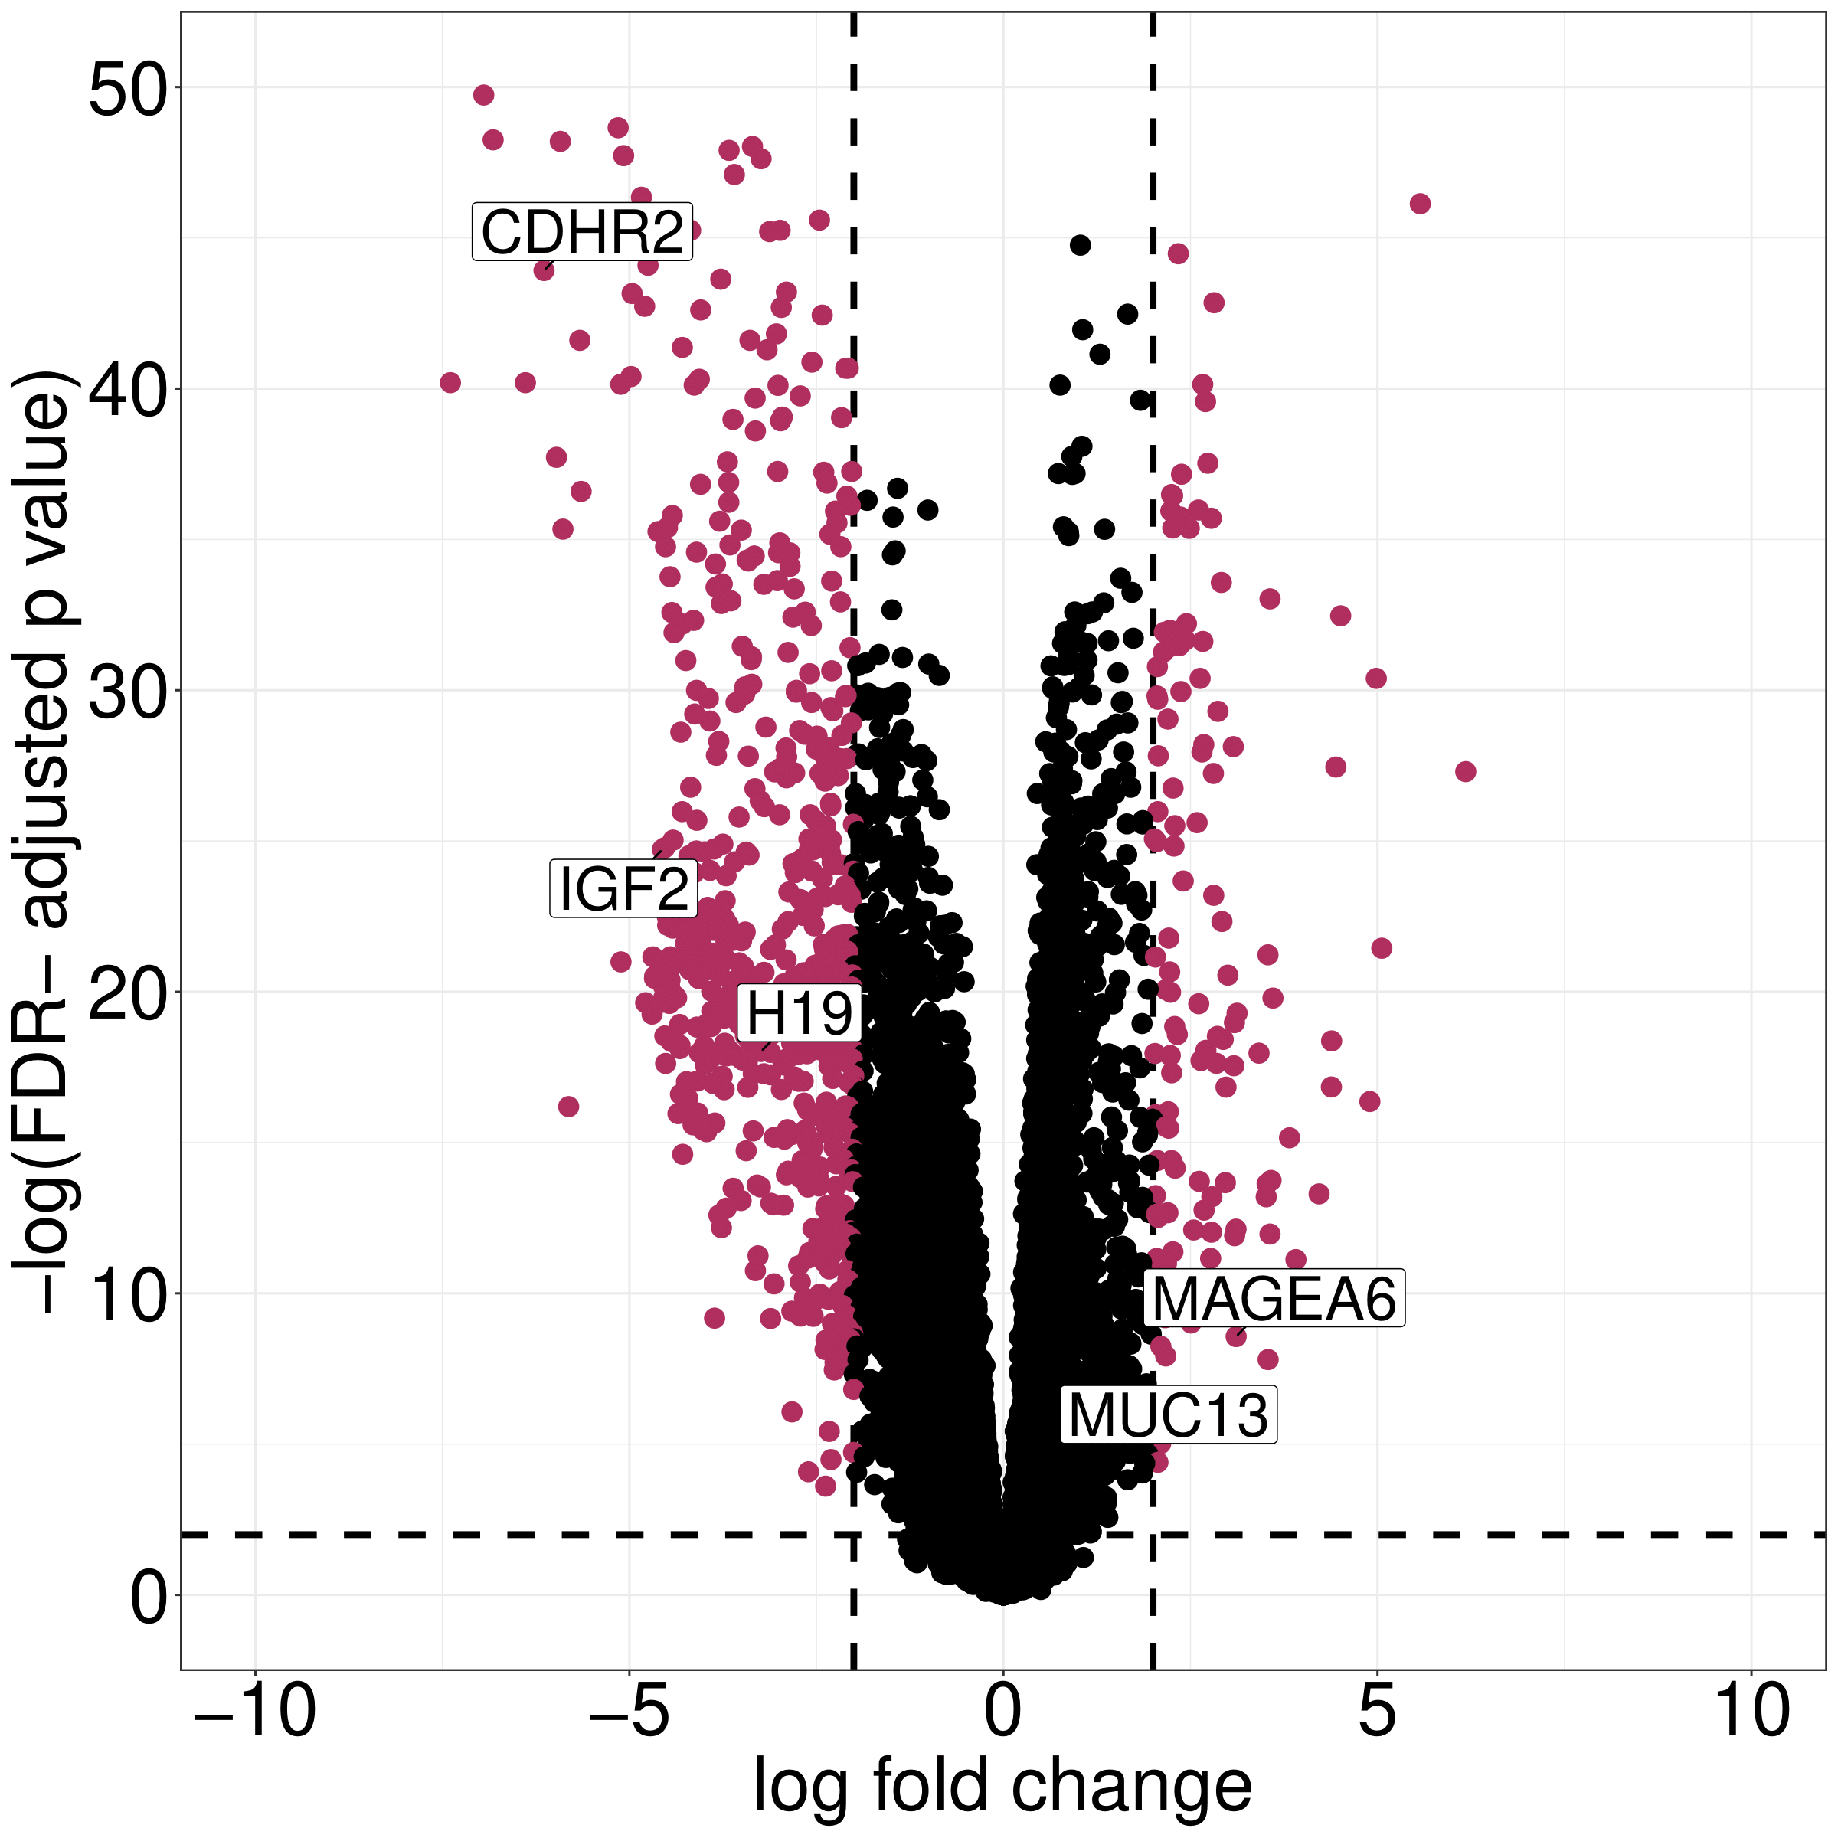
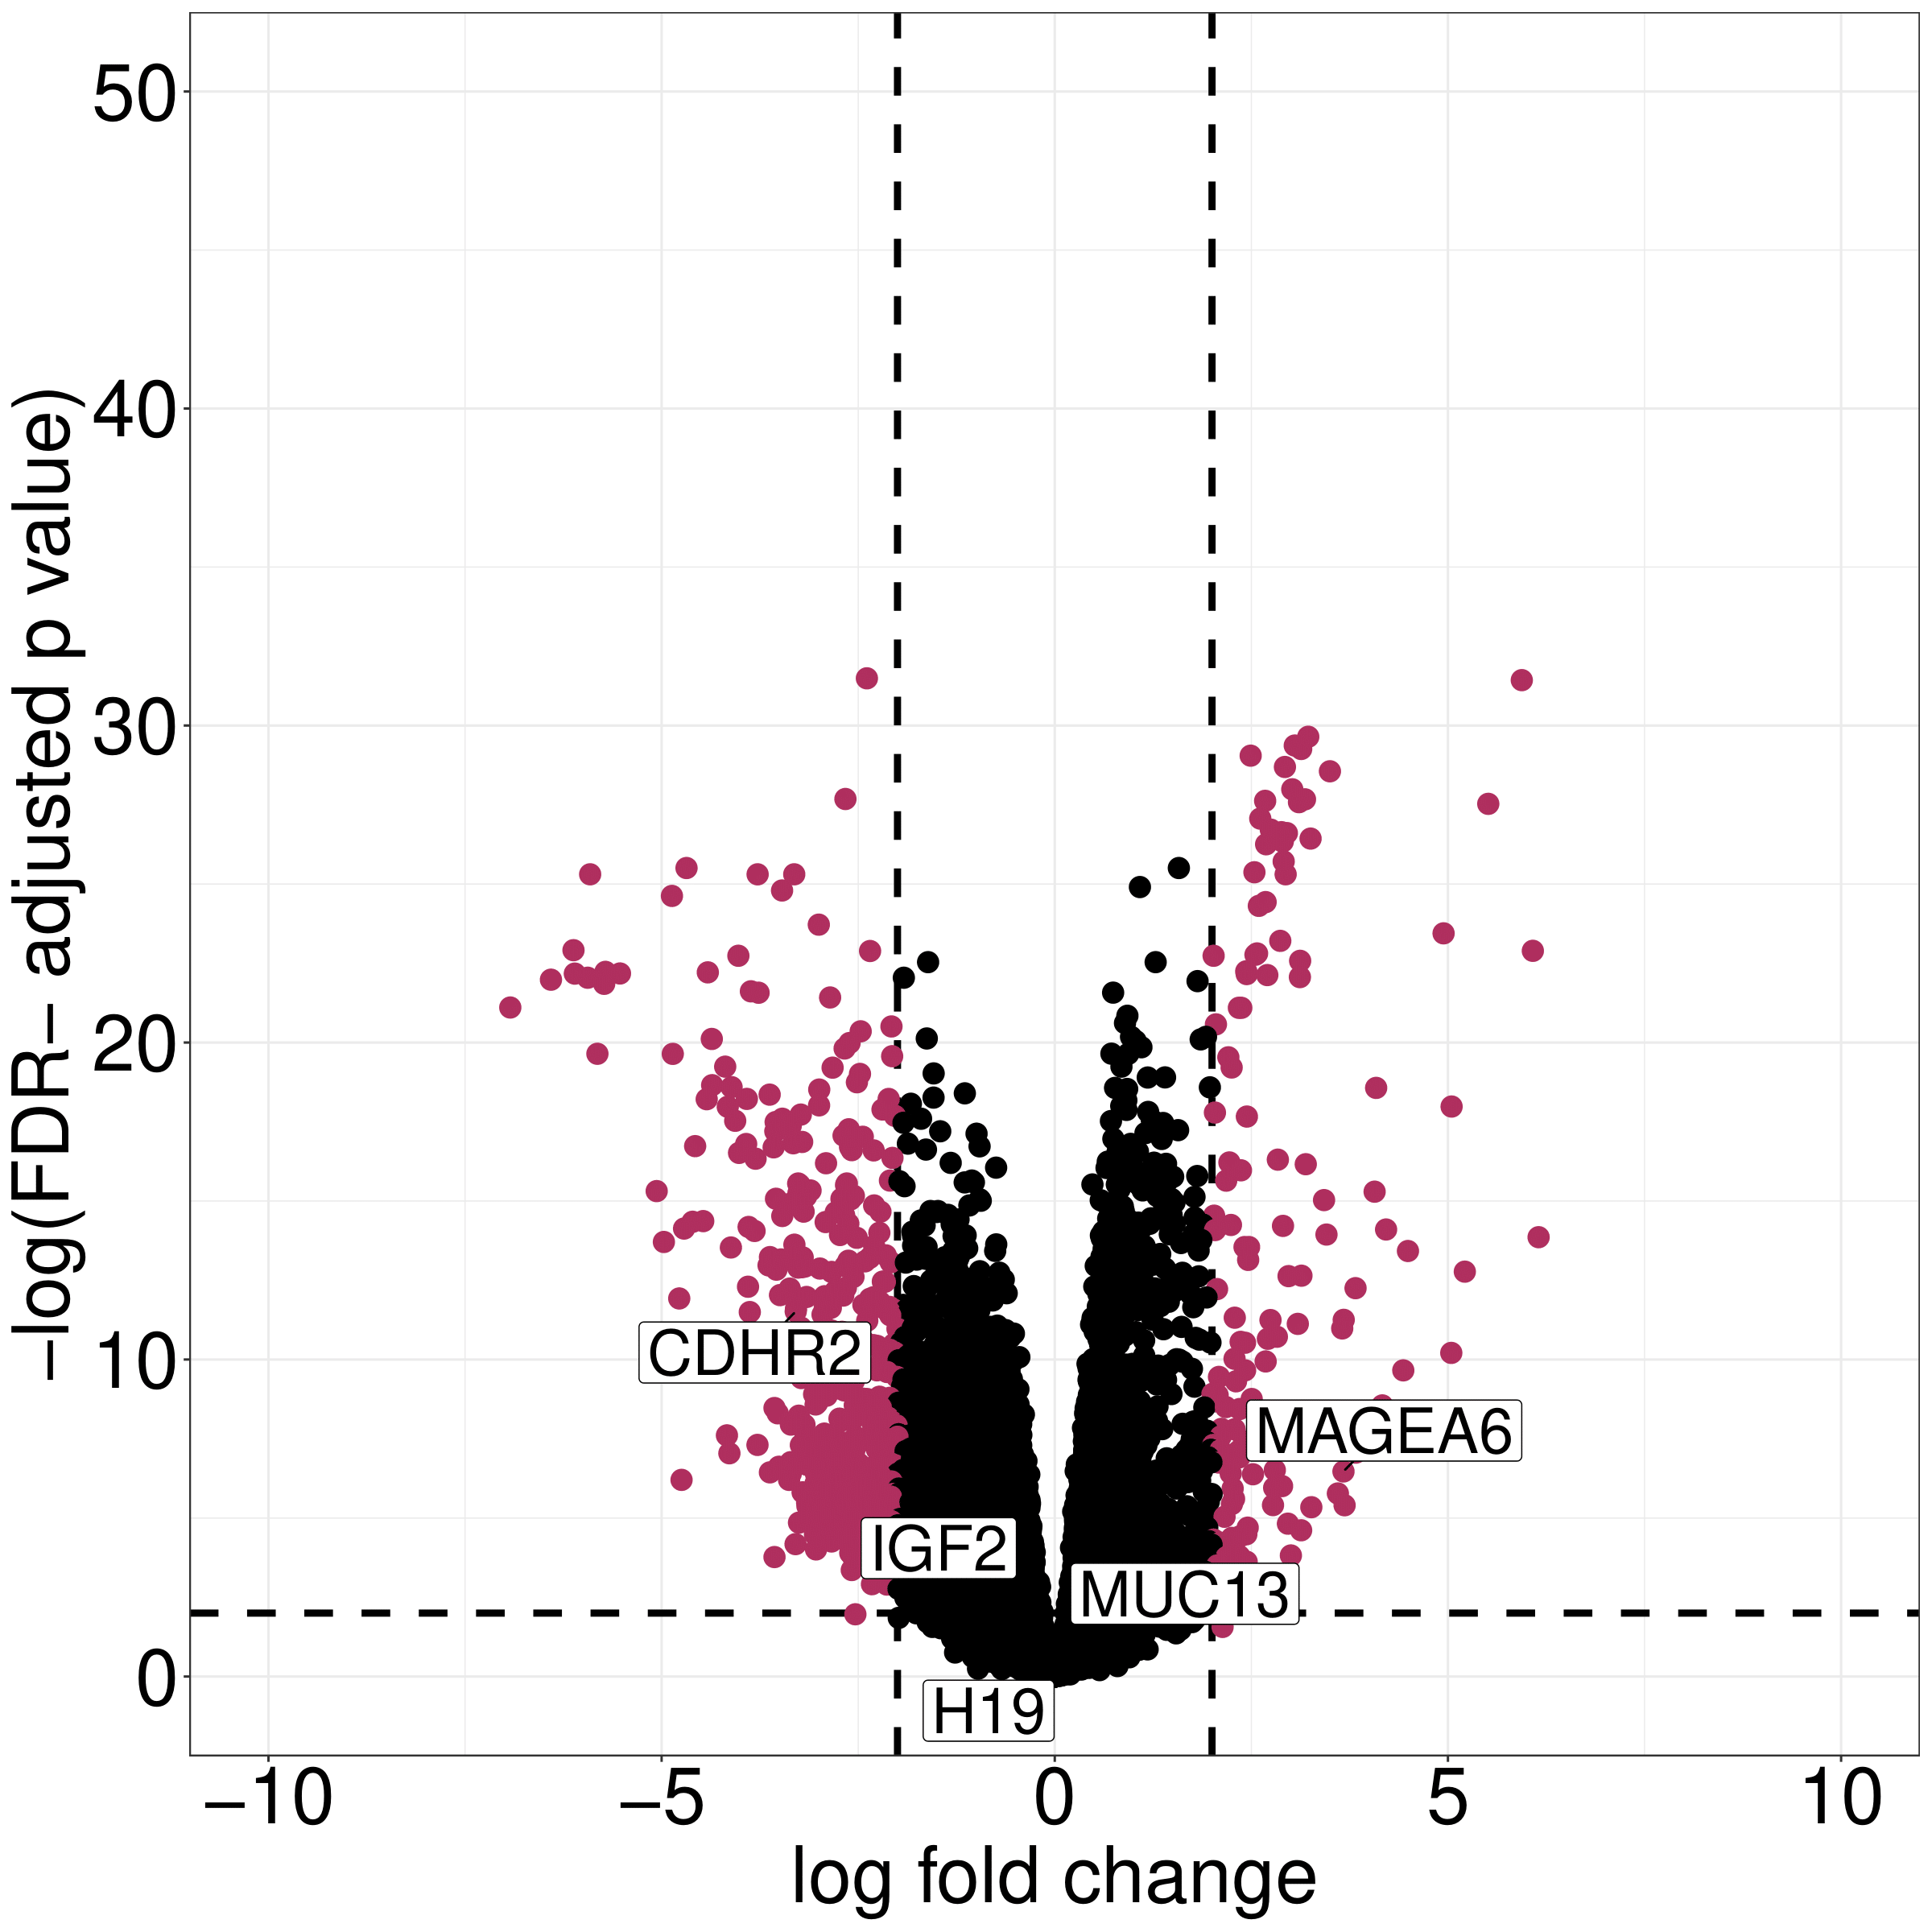
Sex-Differential Expression Analysis in Viral-Mediated Hepatocellular Carcinoma
ANNIKA JORGENSEN¹, ELIZABETH S. BORDEN², MUSA GABERE³ , KAREN TARASZKA HASTINGS², MELISSA A. WILSON², KENNETH H. BUETOW²
1 Arizona State University, Phoenix, Arizona, 2 University of Arizona College of Medicine-Phoenix, Phoenix, Arizona, 3 Mayo Clinic, Phoenix, Arizona
Abstract
Hepatocellular Carcinoma (HCC) is the second deadliest cancer worldwide and is increasing in prevalence in most countries. The majority of HCC cases worldwide are virally-mediated with around 50% mediated by hepatitis B virus (HBV) and 25% mediated by hepatitis C virus (HCV). HCC also exhibits sex-differences with significantly higher incidence and worse prognosis in males. The mechanistic basis of these sex-differences is poorly understood. To identify genes and pathways that are sex-differentially expressed in viral-mediated HCC, we performed differential expression analysis on tumor vs. tumor adjacent samples that were stratified based on sex and viral etiology. We calculated the log fold change (logFC) for all genes between female tumor and tumor-adjacent tissue or male tumor and tumor-adjacent tissue. We then fit a linear regression to the log fold change of each gene between males and females. Top sex-differentially expressed candidates were identified as those with the greatest difference from the linear model. Genes showing the greatest difference between males and females included MUC13, and MAGEA6 for HBV-mediated liver cancer and CDHR2, IGF2, and H19 for HCV-mediated liver cancer. Each of these genes has a previous association with HCC including known roles in the formation of HCC (IGF2) associations with poor prognosis (MUC13, MAGEA6), and prior evidence of tumor to tumor-adjacent differential expression (CDHR2, H19,). Understanding genes and pathways with different expression levels in male and females may contribute to improved individualized therapeutic or diagnostic options for HCC.
Methods
RNAseq data from tumor:tumor-adj. hepatocellular carcinoma samples were obtained from the International Cancer Genome Consortium (ICGC) (Table 1).
Differential expression analysis was performed using limma/voom. The results were stratified by both sex and viral etiology (Figure 1).
Linear regression model fit for the tumor:tumor-adj. log fold changes (logFC) in males vs. females to identify genes with a different expression pattern in males and females (Figure 2).
Expression of top gene candidates from the linear regression analysis were represented visually using violin plots (Figure 3).
A literature search was done on top gene candidates to identify previous associations with HCC and cancer overall (Table 2).
SEX Specific Differentially Expressed genes
LITERATURE SEARCH
Gene | logFC Tumor vs. adj. | Reported differential expression | Reported Function
MUC13 | Positive | Higher in HCC than adjacent tissue (Dai, 2018) | Overexpression associated with poor survival among patients with intrahepatic cholangiocarcinoma (Tiemin, 2020) Associated with resistance to cancer cell death (Sheng, 2016) Potential therapeutic target for colorectal cancers (Sheng, 2016)
MAGEA6 | Positive | Not reported | Gene overexpression inhibits cell migration & invasion of HCC cells (Guo, 2019) Downregulation of gene inhibits stemness maintenance of self-renewal of HCC stem cells (Guo, 2019)
H19 | Negative | Not reported | Repressed in most tissues and re-expressed in many cancers (Gamaev, 2021) Shown to act as an oncogene in mouse models (Gamaev, 2021)
CDHR2 | Negative | Higher in adjacent tissue than HCC (Xia, 2019) | Downregulated in HCC cell lines and tissues (Xia, 2019 ) Novel tumor suppressor in HCC growth in vitro and in vivo (Xia, 2019)
IGF2 | Negative | Higher in HCC than adjacent tissues (Martinex-Quetglas, 2016) | Known to be overexpressed in HCCs (Martinez-Quetglas, 2016) Accelerates formation of liver tumors through IGF 1 receptor signaling (Martinez-Quetglas, 2016)
A
B
Figure 2: Linear Regression identifies genes with the greatest difference in the tumor:tumor-adj logFC between males and females. Maroon dots indicate a residual ≥ 2.25. Genes selected for further research are labeled on the plot. Linear regression model for (A) HBV samples and (B) HCV samples.
 | Male Tumor | Male Adj. | Female Tumor | Female Adj
HBV | 33 | 40 | 8 | 9
HCV | 59 | 71 | 34 | 36
Table 1: Patient sample data taken from the ICGC. More samples available for males than females.
HBV & HCV Volcano Plots
A
B
Figure 1: Differentially expressed genes stratified by sex and etiology. Maroon dots indicate genes with an absolute logFC ≥ 2. Vertical dashed lines represent an absolute logFC ≥ 2 and the horizontal dashed line represents a p-value of 0.05. Genes selected for further research are labeled. Differentially expressed genes shown for (A) male HBV sample (B) female HBV sample, (C) male HCV samples, and (D) female HCV samples.
A
B
C
Table 2 : Literature search shows reported expression and function of the five selected genes
Figure 3: Sex-biased gene expression in HCC. (A) CDHR2 has similar levels of tumor:tumor-adj. expression across all etiologies and sexes. (B) H19 and (C) IGF2 show greater difference between male tumor:tumor-adj. tissue compared to female tumor:tumor-adj. tissue, consistent across HBV and HCV (D) MAGEA6 shows greater expression in all HCV tissue compared to HBV tissue and a greater difference in male tumor:tumor-adj. than female tumor:tumor-adj. tissue (E) MUC13 shows a greater difference between male tumor:tumor-adj. tissue, consistent between HBV and HCV.
Conclusions
CDHR2 has similar levels of tumor adj. expression across all etiologies and sexes.
H19 & IGF2 show a greater difference between male tumor:tumor-adj. expression compared to female tumor:tumor-adj. tissue.
MUC13 & MAGEA6 shows a greater difference in male tumor:tumor-adj. tissue between HBV & HCV.
C
D
Future work
Pathway analysis to investigate potential relationships between genes of interest.
Investigate additional genes showing great tumor:tumor-adj. logFC difference.
D
E
Acknowledgements
This work was supported in part by the Arizona State University Sex Chromosome (A. J., M.A.W, K.H.B), the University of Arizona Cancer Center and the University of Arizona College of Medicine - Phoenix MD/PhD Program (E.S.B.).

